Slide 1


Slide 2
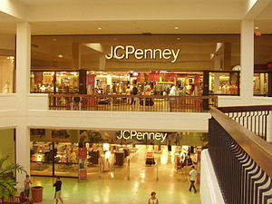

Slide 3

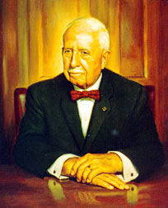

Slide 4
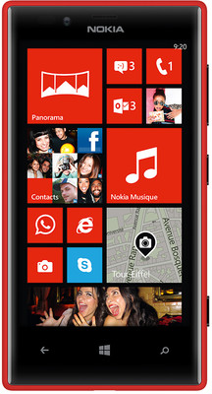

Slide 5

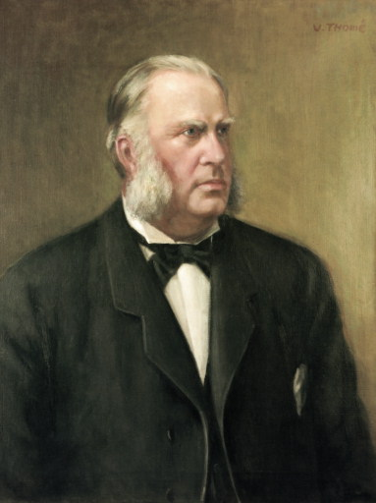
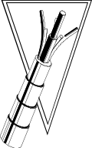

Oy Nokia Ab founded in Tampere in 1865
Soon moved to neighboring town of Nokia
First product was groundwood
Finnish Rubber Works Ltd. founded in
Helsinki in 1898
Soon moved to Nokia
First product was rubber galoshes
Finnish Cable Works Ltd. founded in
Helsinki in 1912
First product was imported copper wire
coated with rubber-impregnated textile layer
Nokia Corporation formed in 1966 through
the merger of Nokia Company, Finnish Rubber
Works and Finnish Cable Works
O
K
N
I
Y
A
A
O
B
1
8
6
5
1898
S
.
G
.
T
.
O
.
Y
.
Fredrik Idestam (1838-1916)
Founder of Nokia
President of Nokia Company 1871-1894
<number> © 2008 Nokia ISB Sharing.ppt /2008-01-16 / DC

Slide 6


Slide 7

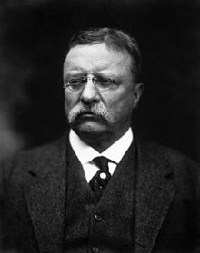

Slide 8


Slide 9

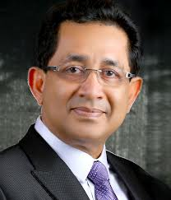

Slide 10



Slide 11



Slide 12


